Slide 1

Education VCE Passing Score- ATAR (or equivalent) of success
GROUP 6
Josh Martin
Peregrin Ryan
Udeshi Pereira

Slide 2

Motivation:
Our group was interested in investigating relationship between Geolocation access to education as well as the effect Private and Public education has on academic success.

Slide 3
Hypothesis: If students within Major Cities such as Melbourne or Geelong, that also receive Private, Non-Gov education then we expect them to have best chance of academic success within Victoria

Slide 4
Our measurement of academic success
The way we measure academic success was mesurating ATAR scores

Slide 5
What is ATAR?
Picture

Slide 6
Our Project Structure: Keep it for me to talk
Questions
We have focused on two main areas as Geolocation and
Mensurating
Analysis
Conclusions

Slide 7

Questions
Is there a relationship with Geolocation and academic success?
YES, Schools closer to Major Cities have better performance academically.
Is there a relationship with Geolocation and the choices of schools?
YES, There are more schools closer to Major Cities.
Which school sector has best chance of success?
Non-Gov schools had best chances of academic success.

Slide 8

Data clean up process
Josh Martin

Slide 9
JOSH

Slide 10
JOSH

Slide 11
DATA Analysis
PEREGRIN RYAN

Slide 12
Defining Geolocation
Major city (Melbourne and Geelong)
Provincial city (e.g., Ballarat and Bendigo)
Provincial centre (e.g., Mildura, Swan Hill)
Large town (e.g., Leongatha, Lorne)
Small town (e.g., Terang, Skipton)
Rural (e.g., Bright, Donald)
Remote (e.g., Orbost).

Slide 13
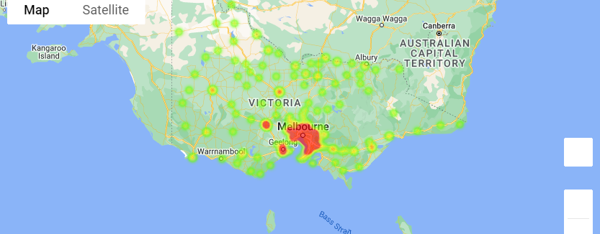
School Geolocation heatmap

Slide 14
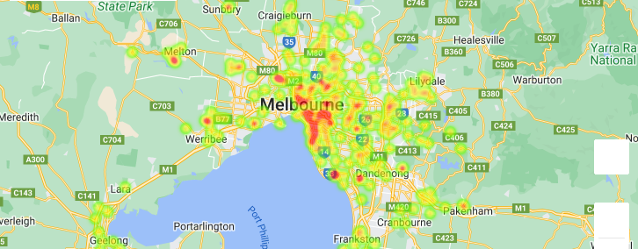
School Geolocation heatmap Major Cities

Slide 15
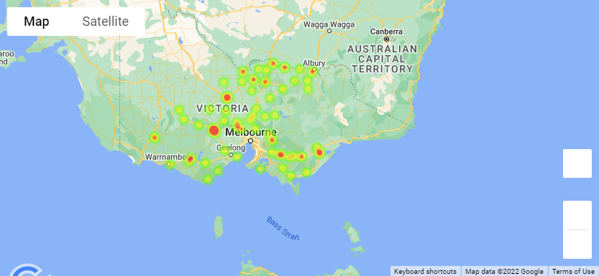
School Geolocation heatmap Inner Regional

Slide 16
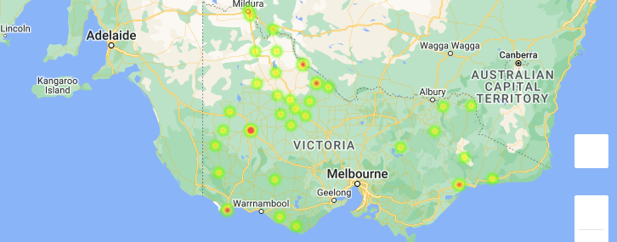
School Geolocation heatmap Outer Regional

Slide 17
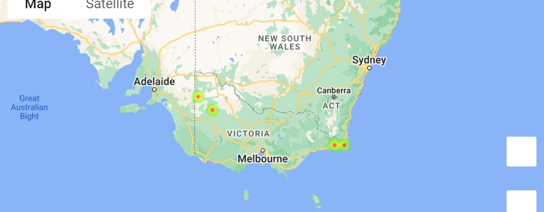
School Geolocation heatmap Remote

Slide 18
Access to education from Geolocation

Slide 19
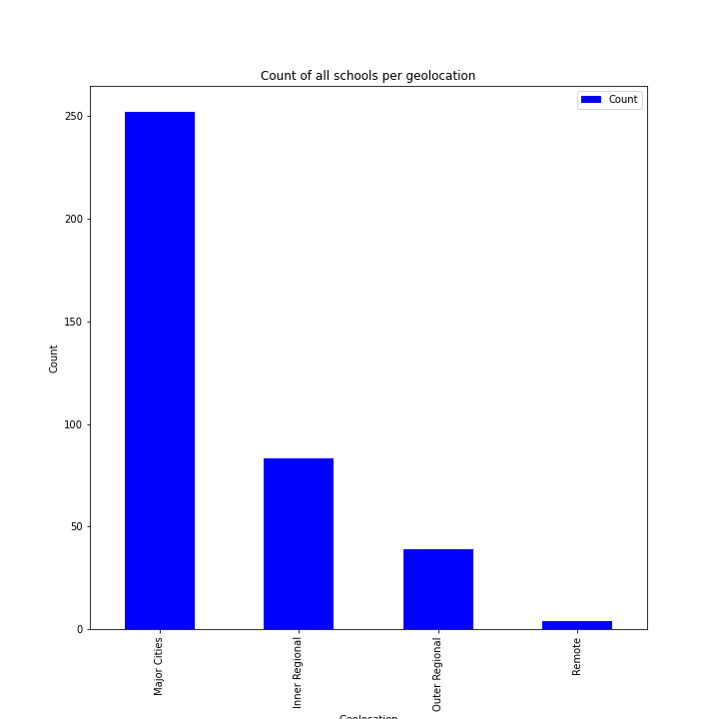
Count of all schools per Geolocation

Slide 20
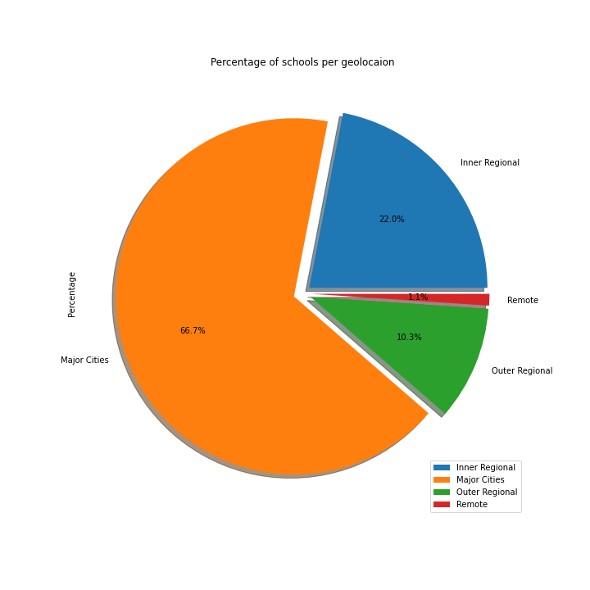
Percentage of schools per Geolocation

Slide 21
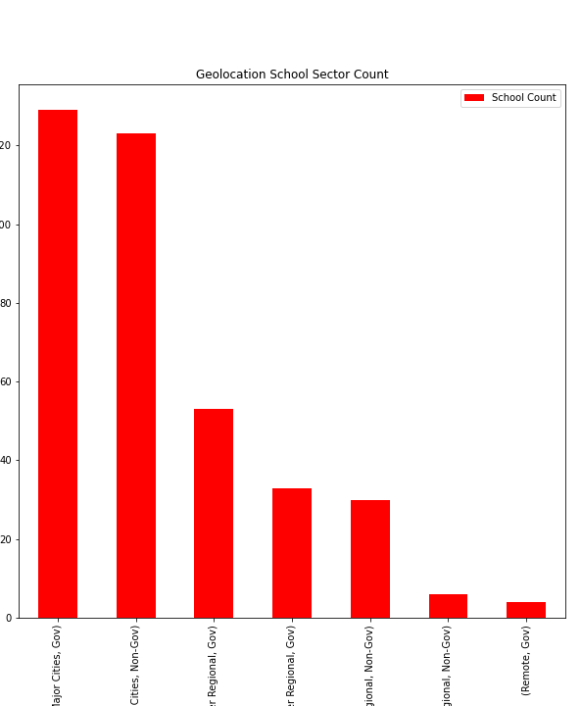
Geolocation School sector count
Which students has more choices of schools between gov or non gov?
Number of school
Number of Gov and Non-gov

Slide 22
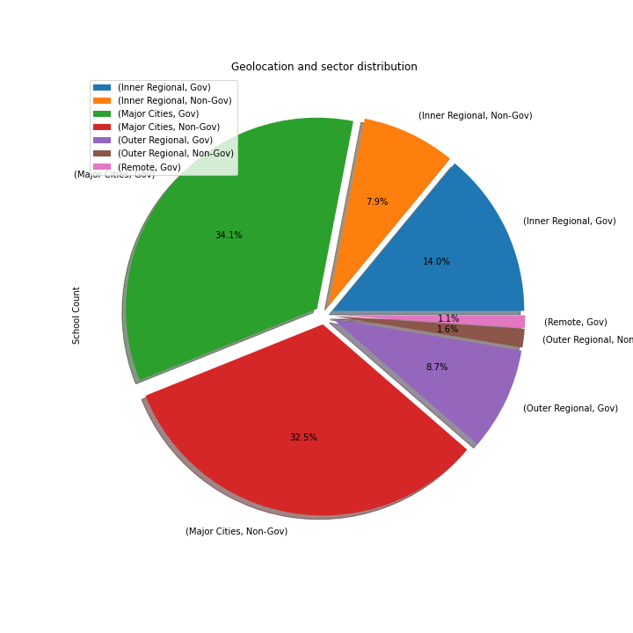
Geolocation and sector distribution

Slide 23
Geolocation and academic success

Slide 24
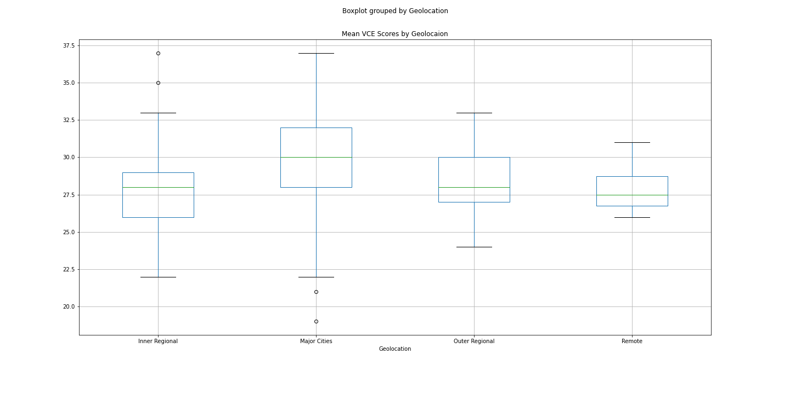
Mean VCE Box Plotting

Slide 25
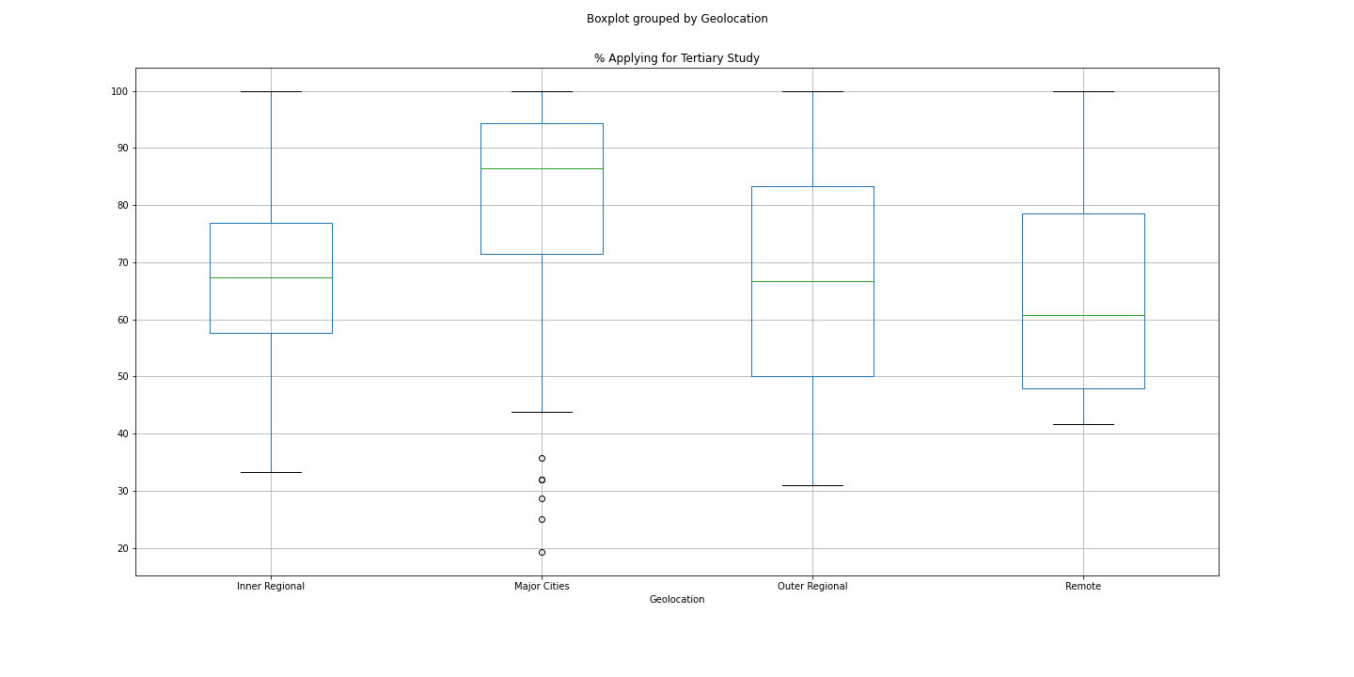
Boxplot grouped by Geolocation

Slide 26
Major Cities school sector distribution

Slide 27
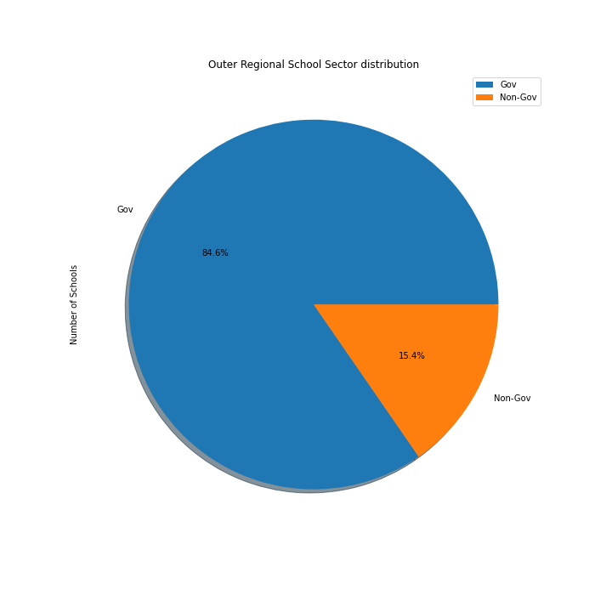

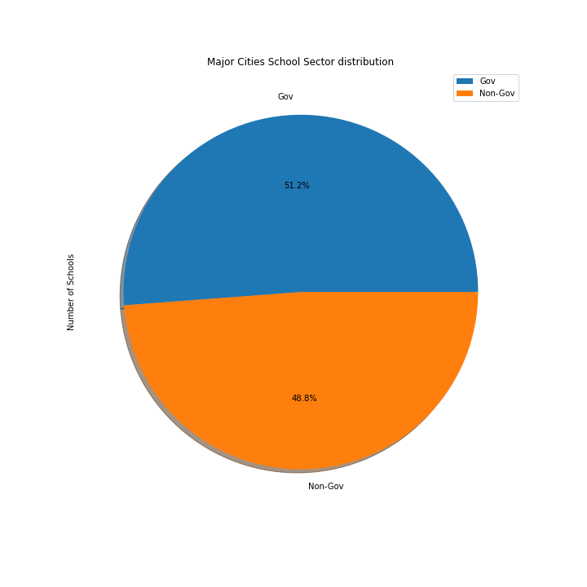

Slide 28
Inner Regional Sector distribution

Slide 29
Outer Regional Sector distribution

Slide 30
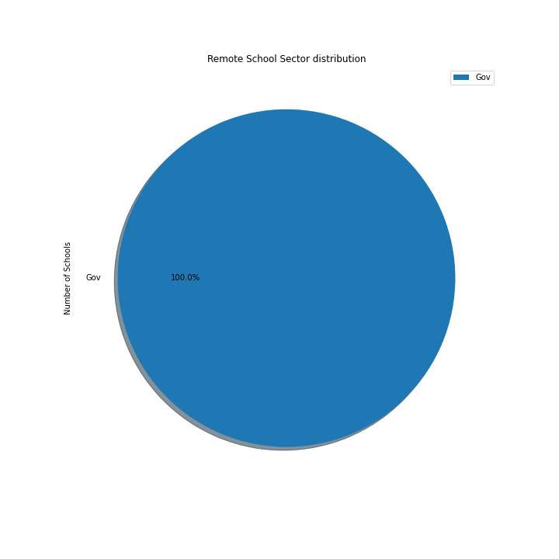
Remote School Sector distribution

Slide 31

The implications of your findings; What do your findings mean?

Slide 32
Which have the best chance of success
01
02
03
Geolocation
(Median ATAR, ATAR over 40% )
Find optimal Geolocation and Gov vs Non-Gov
.
Gov vs Non-Gov
(Median ATAR, ATAR over 40%)

Slide 33


Slide 34
Summary

Slide 35

Conclusion
Rural and Regional schools tend to be smaller than Major Cities schools.
This can have a number of disadvantages as well as benefits for rural and regional students.
On the one hand, class sizes tend to be smaller, students enjoy more individual attention from their teachers, and teachers often know most, if not all, the students.
On the other hand, smaller schools tend to have fewer resources, are often less able to employ specialist staff or offer specialist subjects or programs, have to use composite multigrade classes,
provide fewer opportunities for professional development, have more difficulty recruiting and retaining teachers, provide less support for special needs students and offer fewer options for courses.

Slide 36
Group 6
Peregrin Ryan
Josh Martin
Udeshi Pereira

Slide 37
Goals for Q2
Business opportunities
Added priorities
Employee priorities
Increase customer satisfaction by 2%
Maintain growth
Decrease the number of rotations by at least 2
Ensure the cost of development stays below budget
Interns begin
Indoor rec leagues
Chess tournaments
Big Game watching party

